Slide 1
Simple Jira Agile Metrics via Python and SQL (and Azure) https://github.com/bobk/azurejirametrics
meetup.com - Princeton Lean Coffee
Lightning Talk - Sep 25, 2019
Bob Kozlowski - http://www.robertkozlowski.com
Versatile experienced Agile/SDLC/Jira/Windows/CI/CD DevOps engineer
25 years financial services IT experience - CSM, Microsoft Azure, Windows, ITIL certs
looking for short-term contracting, part-time or full-time roles

Slide 2
Summary
For reporting from Jira, the vast majority of users only use dashboards, Agile boards (scrum or kanban), gadgets and email notifications
However (with minimal code) additional simple, useful and interesting work metrics (Agile and otherwise) can be gathered from Jira
Value proposition: Loading Jira data into a DB sidesteps x-instance limitations (most Jira versions) and allows the use of DB tools (joins, lookup tables, SPs, etc.) along with addition of other data sources to get results + insights not possible via Jira UI alone
This presentation is a quick demo/POC of what is possible, rather than an exhaustive treatment of all metrics
TOPICS:
Accessing Jira + SQL via Python
DEMO: Sample code (Python 3.x) to collect data from Jira cloud projects
Loading data into SQL DB
DEMO: Useful SQL metrics queries based on that data
Exposing the data via SSRS reporting
Questions/feedback
Appendices:
A (Azure Infra), B (Jira-Python access), C (other metrics), D (similar libraries)

Slide 3
Accessing Jira + SQL via Python
Easiest method to access Jira: jira-python library
https://github.com/pycontribs/jira
Much easier to use than direct REST API access - see Appendix B
Install via “pip install jira”, supports both Python 2.7 and 3.x
reasonable functionality set and has all the key tables (issues, JQL, projects, transitions, attachments, history, sprint data, comments)
Easiest method to access SQL: pyodbc library
https://github.com/mkleehammer/pyodbc
Simple, functional interface to ODBC DB data sources
We will use an Azure SQL Server/VM for this demo
Install via “pip install pyodbc”
Demo uses direct SELECT, DELETE and INSERT statements for simplicity
Tables we create = jira_servers, projects, issues, history, metrics
QUICK SAMPLE CODE DEMO

Slide 4
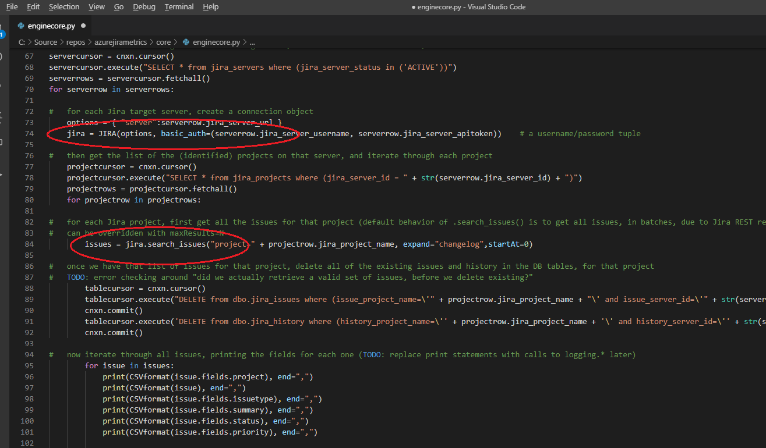

Slide 5
The Most Important “Non-Technical” Agile Success Metrics Are, Of Course, Things Like:
How much Business Value is the Product bringing
to your Organization?
How Satisfied and Engaged are your Customers
and Product Owners?
How Happy and Motivated is your Agile Team?
etc…

Slide 6
But we can now also generate some Simple, Useful, Interesting “Technical” Agile Metrics
First, talk about “improvement” vs “protective” metrics
WIP > N?
Successful Agile teams generally limit WIP, either by person or by team
A single person assigned to more than N “In Progress” issues across all projects/instances
Could be refactored to “team WIP limit” by defining a team table
Using SQL, it is *possible* to do this by general “statuscategory” (an actual JQL variable), rather than specific statuses, which is brittle, e.g.
Issues that required Rework?
Rework (cards moving right to left) generally means waste
missing/bad unit/integration/functional tests?
human error for something that should be automated?
Issues moved to a Done status, then back to an “In Progress” status
It is possible to do this (awkwardly) via JQL using the “status changed from” or “was” operators, but again not across instances or taking into account board columns
QUICK CODE DEMO of SQL SP

Slide 7
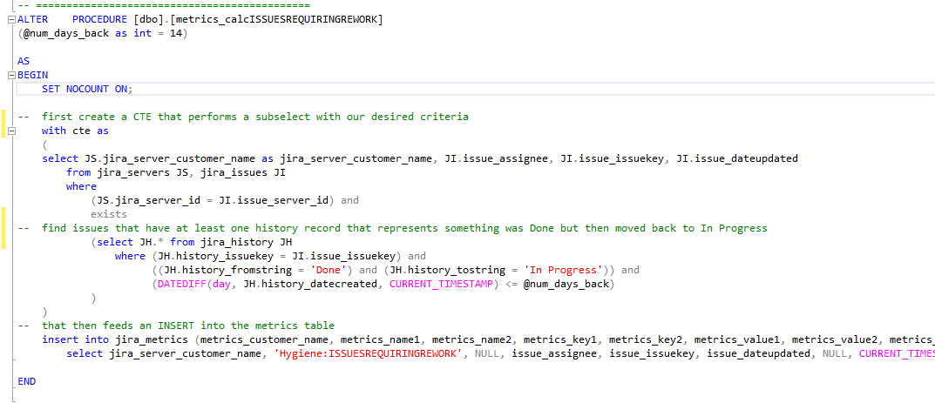

Slide 8
Simple, Useful, Interesting “Technical” Agile Metrics (continued)
Issues taking > N days?
Last move to In Progress was > N days ago - some teams may want to limit cards to N days (as a result of breaking up larger stories into smaller tasks)
This is not necessarily a big problem in and of itself – needs to be used judiciously
Issues not updated in N days?
Updated = any field - some dev teams have conventions about updates to issues (comments, history, pull requests/check-ins)
if an issue hasn’t been updated in > N days, someone may want to know (is the developer struggling, has the issue been forgotten about, should it be flagged impediment/blocker?)
Most SCM products (Git, Perforce, etc.) store basic extended properties in Jira custom fields (“cf[xxxx]”) that will also touch the lastupdated time field
Lead Time
With Cycle Time and others, this is one measure of how soon work gets to the Customer
Different definitions used by different teams:
https://community.atlassian.com/t5/Jira-discussions/Understanding-the-Cycle-Time-of-Epics-in-Jira/td-p/621785
For Kanban/Lean, compare date added to Backlog to date moved to Done (Not always the same as JQL “fixversion changed”)
For Scrum, compare date issue inserted into Sprint, to date moved to Done (assume Done date = deployment date)
QUICK CODE DEMO of SQL SP + SSRS REPORT
The CHANGELOG option (to get History) in the REST API is key for many interesting Agile metrics

Slide 9
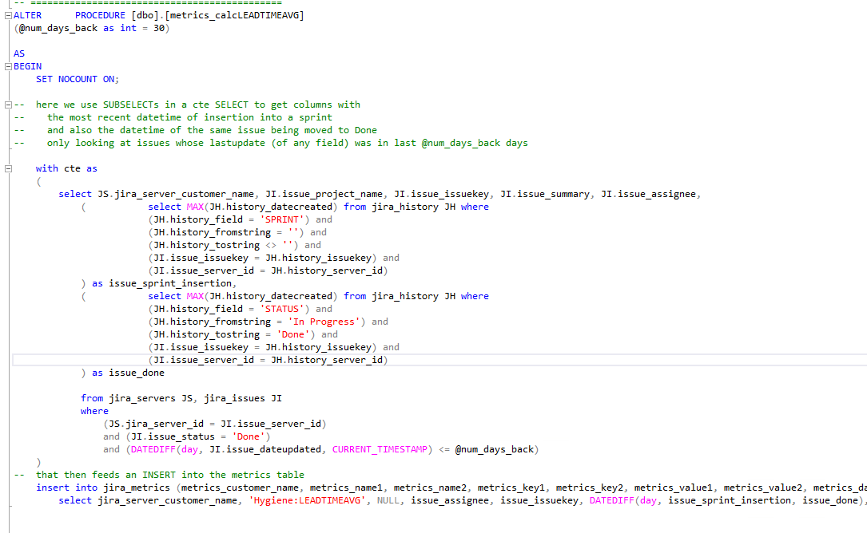

Slide 10
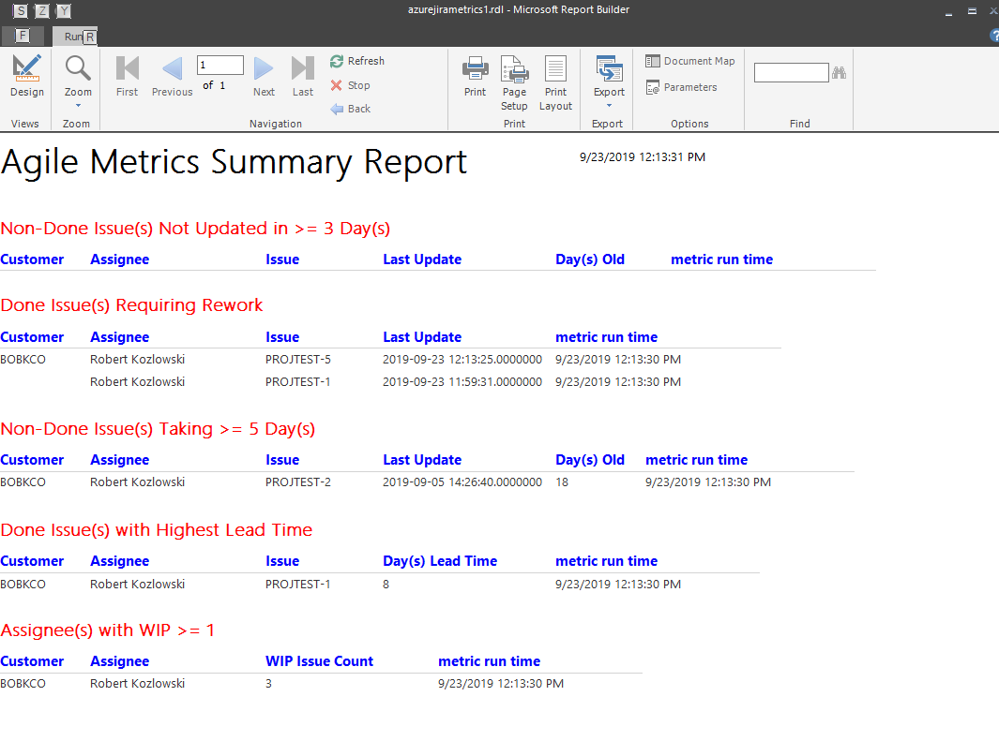

Slide 11
Questions/Feedback?
Thank You!
Robert Kozlowski
http://www.robertkozlowski.com

Slide 12
Appendix A: Azure Infra
Python code runs on Azure WS2016 VM
Prefer a container? dockerfile for Ubuntu 18 is also provided in repo
VM configured as build agent with manual deploy step in Azure DevOps
Azure SQL Database instance holds all collected data
List of Jira Cloud instances is stored in jira_servers table
DB DDL and SPs are in repo
Microsoft SSRS running on Azure Windows VM for reporting
SSRS report files are in repo
If you want to test these reports yourself, create a Jira Cloud project, send me read-only access info, and I will add the Jira project to my tables and generate a sample report for you
https://azurejirametrics.atlassian.net
https://github.com/bobk/azurejirametrics

Slide 13
Appendix B: Jira-Python access
Method 1: jira-python library
https://github.com/pycontribs/jira
Much easier to use
Install via “pip install jira”, supports both Python 2.7 and 3.x
Limited functionality but has all the basics (issues, JQL, projects, transitions, attachments, history, sprint data, comments)
Method 2: direct REST API access
https://docs.atlassian.com/software/jira/docs/api/REST/8.3.3/
Harder to use, requires basic REST API understanding
Results typically in JSON and need to be parsed
Extensive functionality (almost nothing is hidden or inaccessible)
Only realistic way to get some “extended” Jira data

Slide 14
Appendix C: Other Metrics?
Things that you can potentially calculate (either via the below or the way you want) once you get all your Jira data into a SQL database:
Cycle Time:
https://community.atlassian.com/t5/Jira-discussions/Understanding-the-Cycle-Time-of-Epics-in-Jira/td-p/621785
Generally defined as time “In Progress”
https://codeclimate.com/blog/software-engineering-cycle-time/
More specifically, could be from first commit to date moved to Done (assume Done = deployment)
SCM tools that integrate with Jira (e.g. Git Integration for Jira) sometimes add custom “cf[]” fields for SCM metadata like commit info
Release Frequency/Interval:
Look at Jira Versions, see what dates they or their constituent issues are moved to Done and perhaps correlate them with change management data?
Change Size:
Number of contained issues in a Version, Epic or Sprint
Different from story point total? Number of total final SCM commits? (very coarse)
Velocity:
https://coalition.agileuprising.com/t/normalizing-story-points-across-an-art/927/9
For a change of pace, normalize by team size, say, over a 12 month period?
Defect Density per Cycle:
https://www.guru99.com/defect-density-software-testing-terminology.html
Number of Bug issues in a sprint (or Epic?) divided by total issues

Slide 15
Appendix D: Similar Libraries
https://github.com/DeloitteDigitalUK
Good graphics capabilities, web server in container
Predefined metrics

